Slide 1

AUTO-FILLER
FORM AUTO-COMPLETION USING OCR
Mentor: Wajid Bin Aqeel

Slide 2
Group Members
Muhammad Mustafa Bawany
Muhammad Yaseen Amir
Ibad Saleem
S M Bilal Arshad

Slide 3
Progress
Pre-processing of images using OpenCV
Text extraction from images using different types of OCR
Optimization of extracted text
Extraction of Name, Contact No and Email
Deployment almost completed

Slide 4
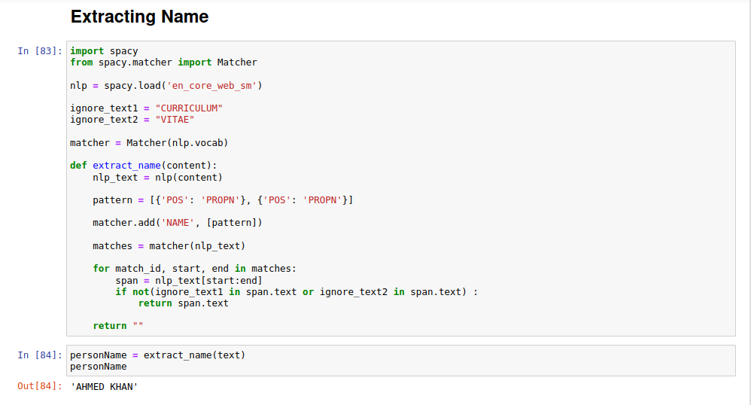
Name Extraction

Slide 5
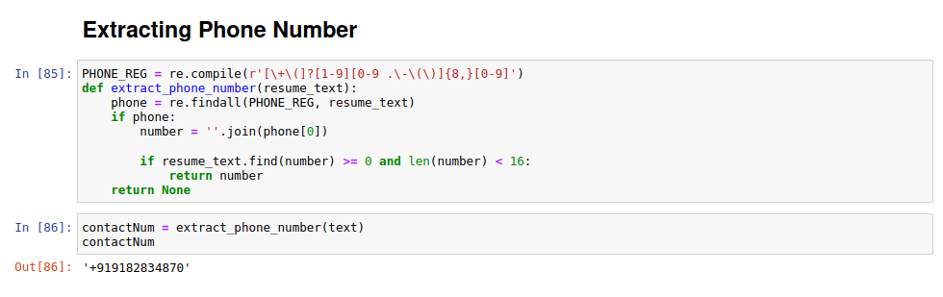
Contact Number Extraction

Slide 6
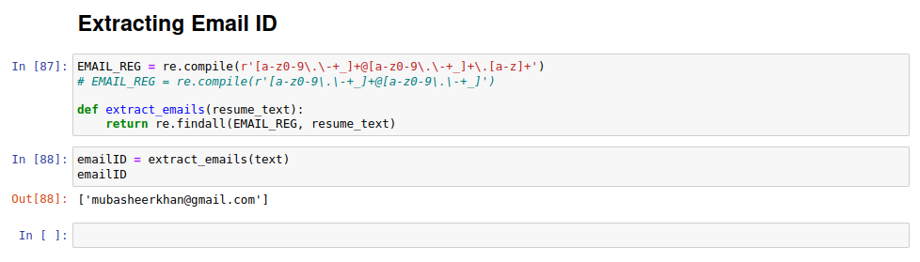
Email Extraction

Slide 7
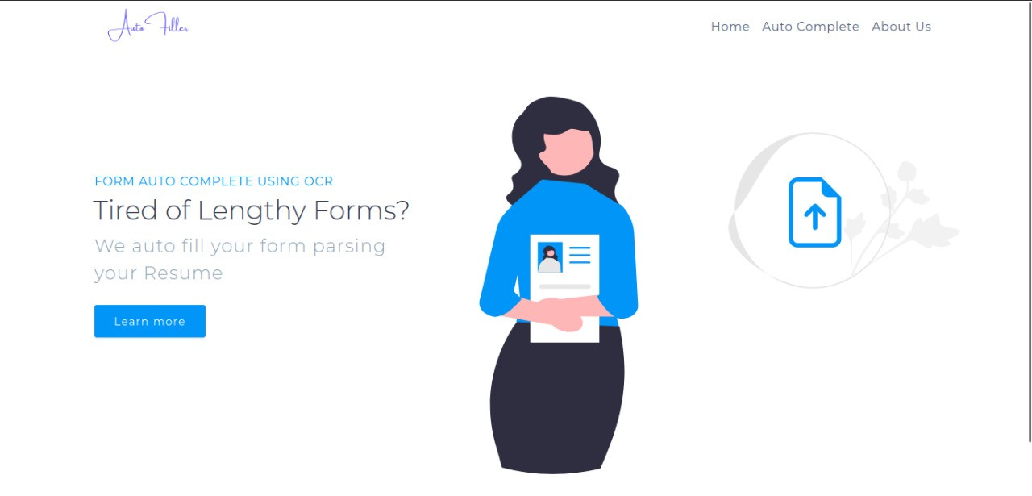
Graphical User Interface

Slide 8
Tools & Technologies Used
Google Colab
Pytesseract OCR
Easy OCR
NLTK
Spacy
Regular Expressions
FAST API
HTML & CSS
Docker

